Slide 1
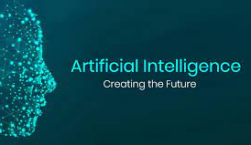
AI Applications
Workshop
By Yuanqi Du

Slide 2


What is Artificial Intelligence?
Weak AI
Simulate human behavior
Strong AI
Act/think exactly like human

Slide 3
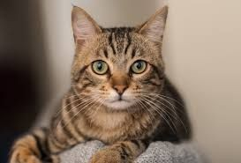
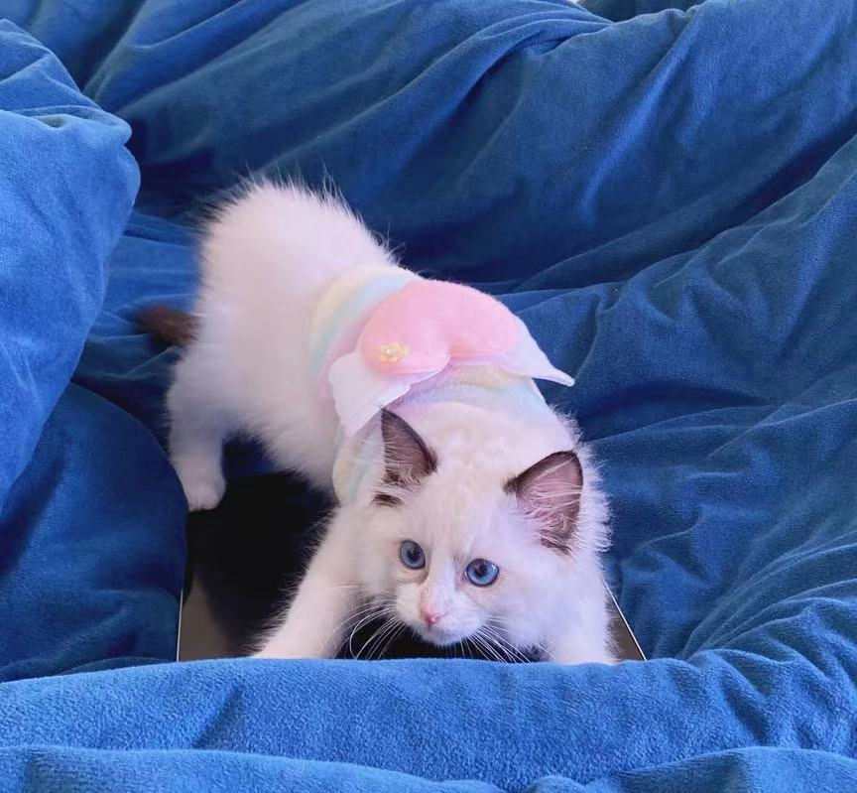


What is Artificial Intelligence?
Intelligence
Learning
Different approaches
Data
Machine learning
Deep learning
And more...
Model
Cat
Prediction

Slide 4
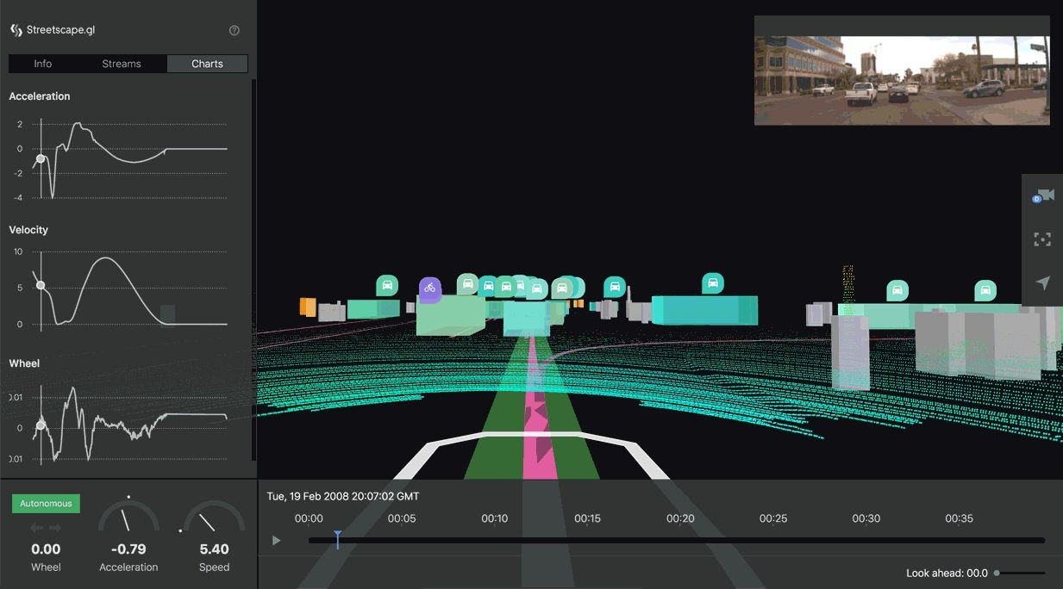
Applications
Computer Vision
Ex. Self-driving car
Natural Language
Ex. Language Translation
Generative modeling
Ex. Deep Fakes
And more...
(AVS, Uber)

Slide 5
Look inside
Data
Where is data from?
Cleaning
Pre-processing
Task
Classification
Clustering
Anomaly Detection
And more...

Slide 6
Look inside
Model
K Nearest Neighbors
Tree-based Models
Deep Learning
And more...
Evaluation
How good is the model? Metrics? Accuracy?
Does the model generalize to all data? Overfitting? Underfitting?

Slide 7
Feel overwhelmed?
Don’t worry. You don’t need to implement any of these approaches on your own. (But you can if you want)
Open source libraries and frameworks save you!

Slide 8
Look inside
Open source libraries
Numpy, Scipy, Pandas (data processing)
Scikit-learn (Machine Learning/Data Mining)
Tensorflow, Pytorch (Deep Learning)
Matplotlib (Visualizer)
And more...
Now, Let’s see several real world applications solved by using these library functions!

Slide 9
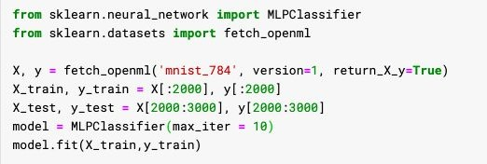
Digits Image Classification
MNIST Dataset:
Want to classify images of handwritten digits

Slide 10
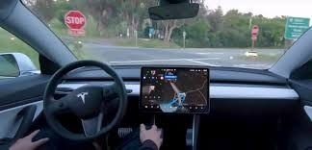
Self-driving Car
Object Detection
Image Segmentation
Multi-sensor system

Slide 11
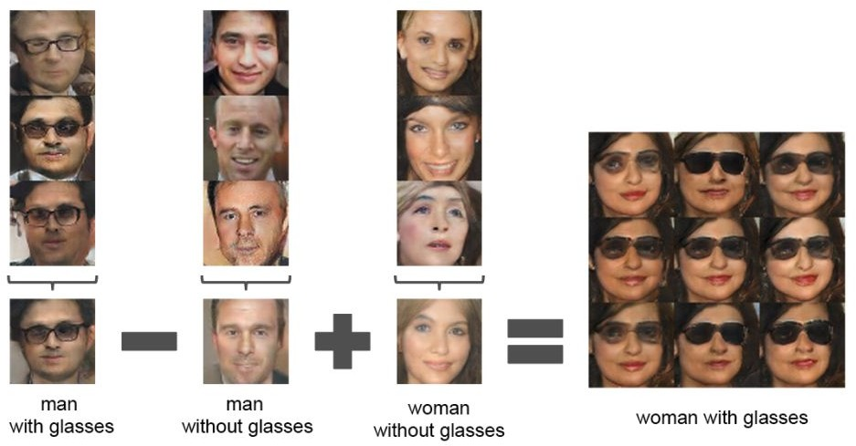
Generative models
E.g. Deepfakes

Slide 12
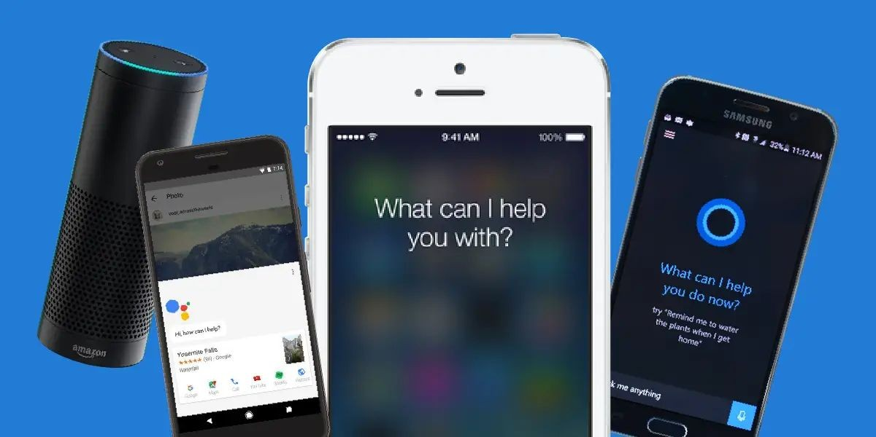
Speech Recognition
Apple - Hi, Siri.
Amazon - Hello, Alexa.
Installed on more apps…
Once it detects the wake-up words, it will start to recognize your speech, and may do translation or do some operations (e.g. set up an alarm).

Slide 13
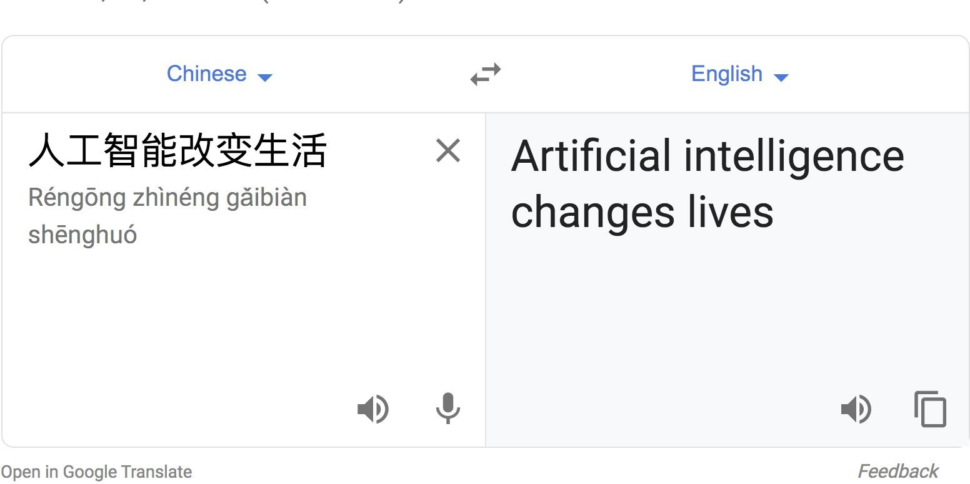
Machine Translation
Google Translate

Slide 14
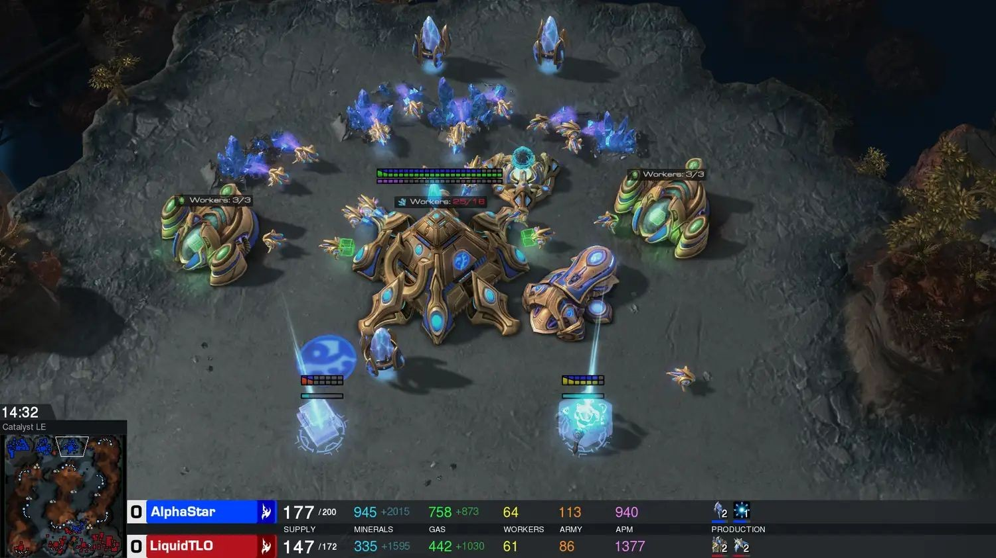

Game Agent
Game AI agent: DeepBlue for chess, AlphaGo for go, AlphaStar for StarCraft II
AlphaStar vs human player
AlphaGo vs Go world champion

Slide 15
All of the above topics form the active research areas and applications

Slide 16
Research fields
Computer Vision
Natural Language Processing
Generative Modelling
Reinforcement Learning
And more...

Slide 17
To be continued...
We will cover more on the ideas of how AI and Machine Learning algorithms work, and how to use the library functions on your specific task in the following workshops!

Slide 18
https://readwrite.com/2020/08/11/guide-to-understanding-artificial-intelligence/

